Slide 1
Efficient Scalability and Task Management: Unleashing the Power of Distributed Systems with Celery

Slide 2
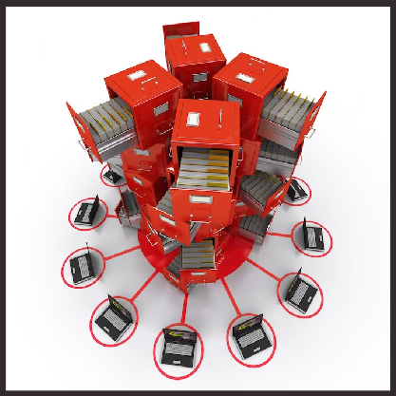
Introduction
Welcome to the presentation on Efﬁcient Scalability and Task Management. In this session, we will explore how Celery helps unleash the power of distributed systems. We will discuss the importance of efﬁcient scalability and task management in today's fast-paced world of technology.
Join us as we dive into the world of distributed computing and discover how Celery can revolutionize your workﬂow!

Slide 3

Scalability is the ability of a system to handle increasing workloads and growing demands. With Celery, you can effortlessly scale your applications to meet the needs of your users. Distributed task queues enable parallel processing, allowing you to efﬁciently handle heavy workloads. Say goodbye to performance bottlenecks and hello to seamless scalability!

Slide 4

Task Management
Effective task management is crucial for maximizing productivity and ensuring smooth operations. Celery provides a powerful task scheduling and execution framework. With features like task prioritization, retry mechanisms, and monitoring tools, you can efﬁciently manage and track the progress of your tasks. Experience streamlined task management with Celery!

Slide 5

Distributed Systems
Distributed systems are a collection of interconnected computers that work together to achieve a common goal. Celery harnesses the potential of distributed systems by enabling asynchronous communication and resource sharing.
With Celery, you can leverage the power of multiple machines to handle complex tasks and achieve efﬁcient resource utilization.

Slide 6

Celery offers numerous beneﬁts for efﬁcient scalability and task management. It provides fault-tolerant and reliable task execution, ensuring that your tasks are completed even in the face of failures. With Celery's ﬂexible conﬁguration and integration options, you can seamlessly incorporate it into your existing workﬂow. Experience enhanced productivity and efﬁciency with Celery!

Slide 7

Conclusion
In this presentation, we have explored the power of Celery in achieving efﬁcient scalability and task management in distributed systems. Celery empowers developers to handle increasing workloads, manage tasks effectively, and harness the potential of distributed computing. Embrace Celery and unlock the full potential of your applications.
Thank you for joining us today!

Slide 8
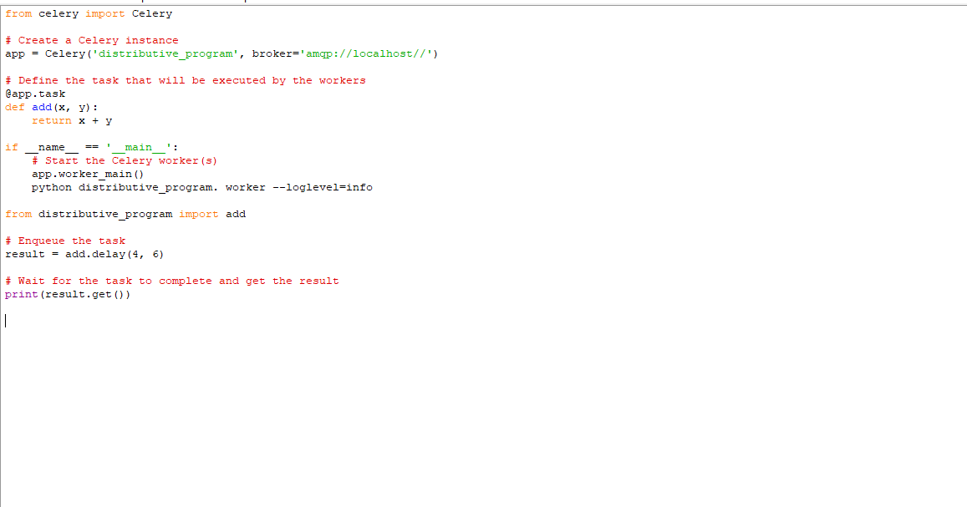

Slide 9
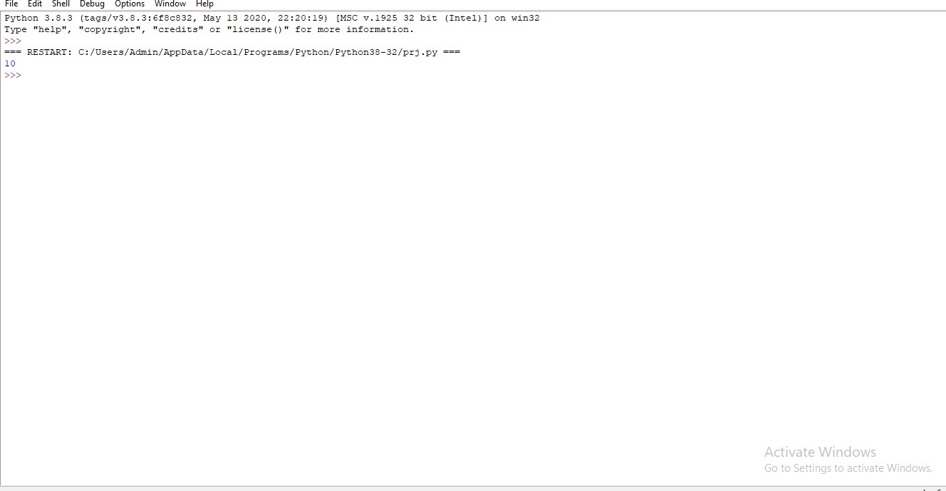

Slide 10
THANK YOU

